Slide 1
SANDY SPRINGS CITY COUNCIL MEETING
February 20, 2017

Slide 2
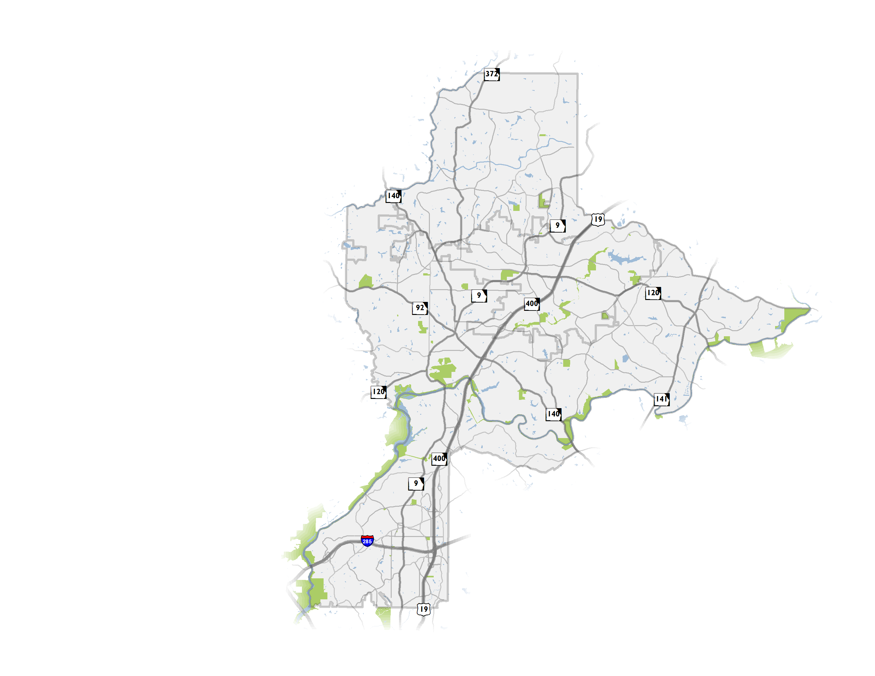
NFCTP Update
Update to initial 2010 Plan
Partnership of 6 North Fulton Cities and the Atlanta Regional Commission (ARC)
Establishment of a vision for transportation
Both local and regional projects, transportation policies
2

Slide 3
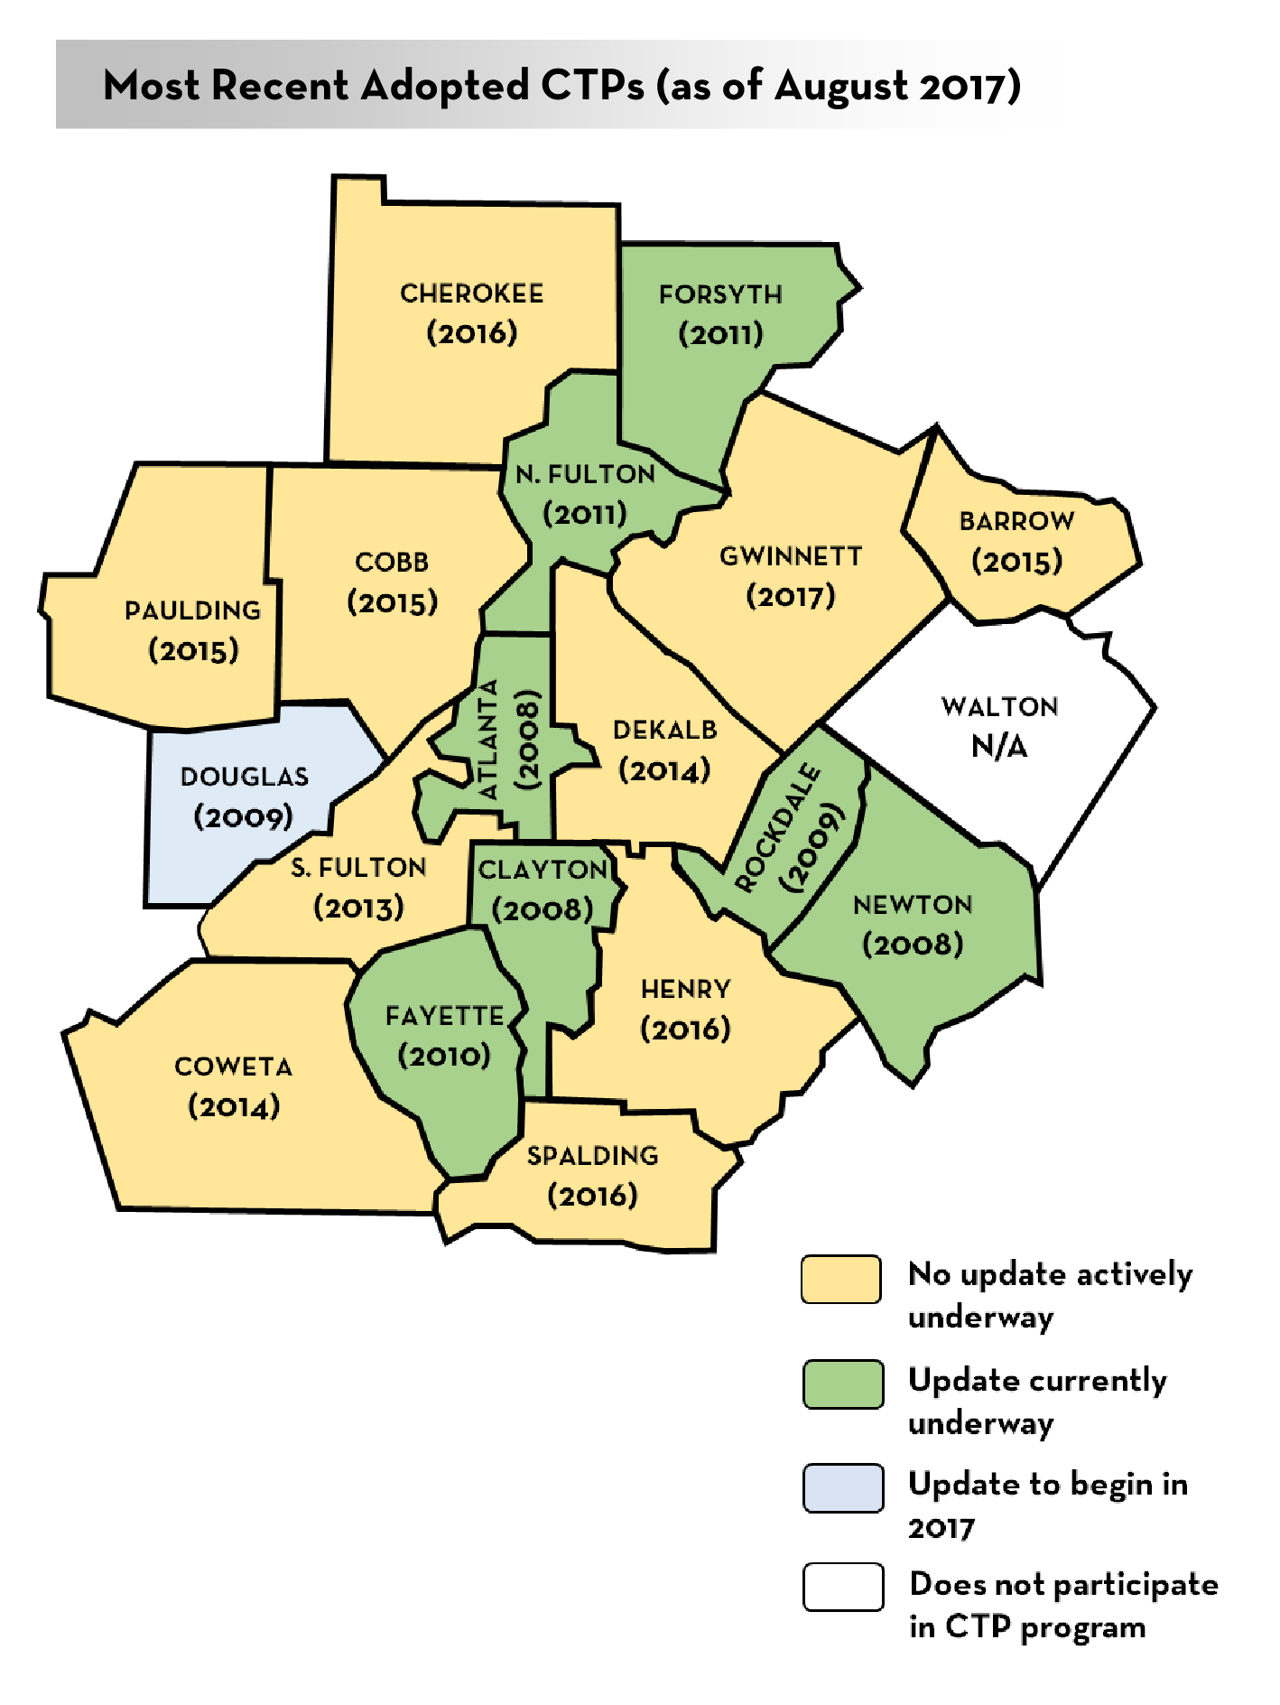
The CTP Program
Atlanta Region’s Plan is informed primarily by CTPs
ARC provides financial assistance to counties (80:20 split)
CTPs help the region to fill federally required plan elements indicated in Code of Federal Regulations*
Participation not required but is an accepted practice across metro Atlanta (18 CTPs currently inform the RTP)
*(CFR; Title 23 CFR 450.306; CFR 450.322)
3

Slide 4
Fulton County Transit Master Plan
Plan resulted in a market-based vision and four scenarios based on various funding levels for high-capacity transit
On January 29, 2018, Fulton County Commission and Mayors reached general consensus on:
To pursue up to a ½ cent sales tax for transit
Based upon the BRT/ART scenario, as an actionable starting point
Leaving open the potential for future rail extensions with other funding sources
The transit scenarios depend on changes in transit governance and funding at a state level and a likely sales tax referendum
Notes:
Rail extensions considered – GA 400, I-285, South Fulton Parkway, I-20 West, South line to Clayton County (through Hapeville)

Slide 5
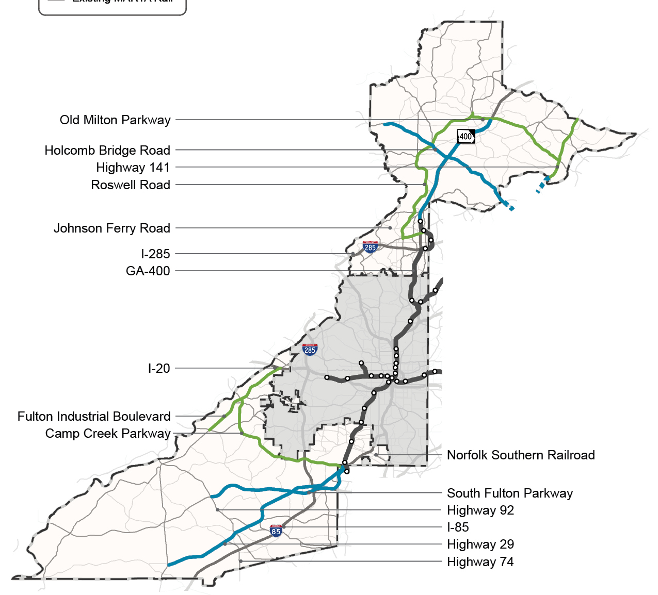
½-Cent Transit Sales Tax with BRT/ART
Bus Rapid Transit
GA 400 to Old Milton
Holcomb Bridge Road
Highway 29
South Fulton Parkway to Highway 92
Arterial Rapid Transit
Roswell Road
Old Milton Parkway
Highway 141
Fulton Industrial Boulevard
Camp Creek Parkway

Slide 6
NFCTP Projects

Slide 7
Project Universe for Sandy Springs
NFCTP 2017 assesses the project universe and vets the need for projects identified in previous efforts and searches for projects to “get in the queue”
Projects considered came from a variety of sources
Projects can be complementary to the Fulton County Transit Master Plan effort
Projects improve access to and from existing and proposed transit stations through a variety of modes (roadway operational, trail, bicycle, and pedestrian)
*Note: a consistent legend is used for the maps on the following pages. Not all project types in the legend are reflected in each map.
7

Slide 8
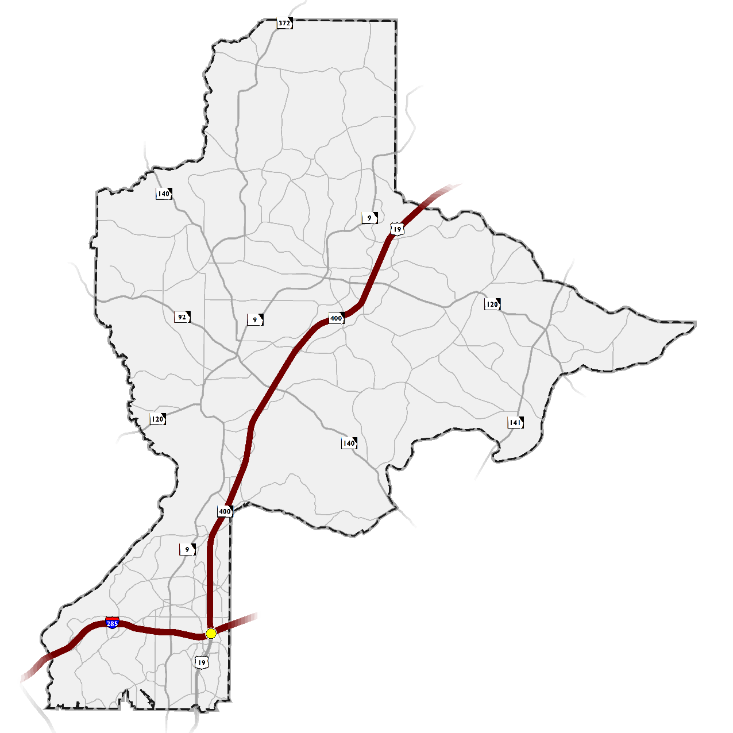
Regionally Significant Initiatives
What’s included?
SR 400 Express Lanes
Transform 285/400
Revive 285 Express Lanes

Slide 9
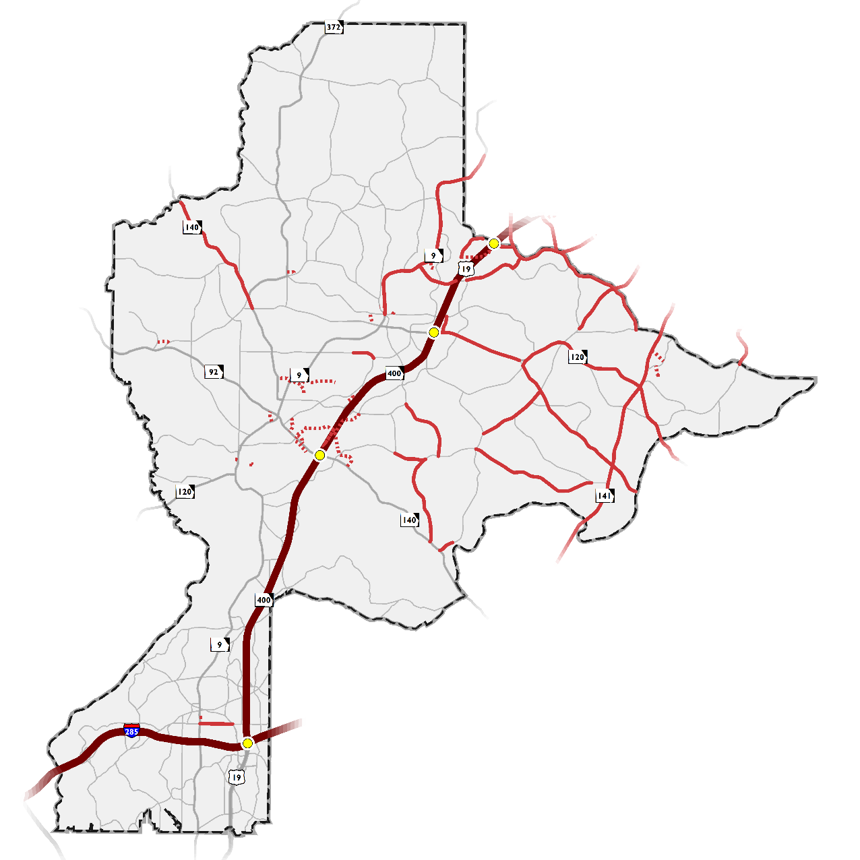
Capacity and New Location
Purpose: widen existing roads or extend/construct new roadways
What’s included?
Support regionally significant projects
Alleviate bottlenecks
Allow local traffic to be diverted on alternative roadways

Slide 10
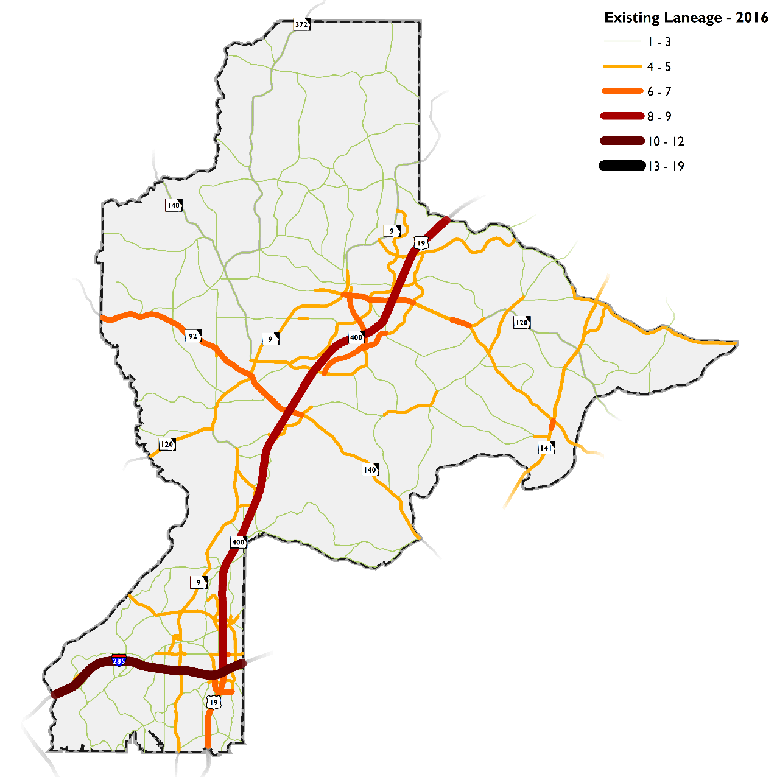
Existing Laneage
Inconsistency in laneage through major corridors

Slide 11
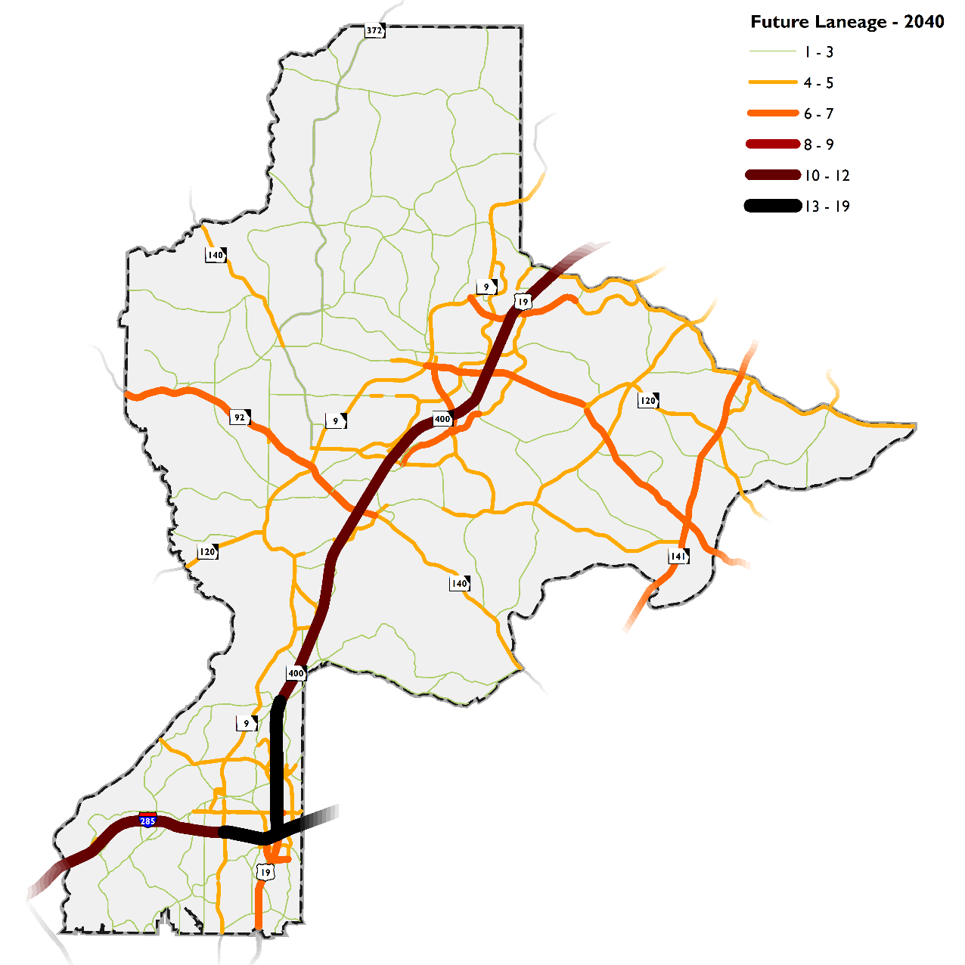
Future Laneage
Streamlines laneage (in North Fulton and across county lines)

Slide 12
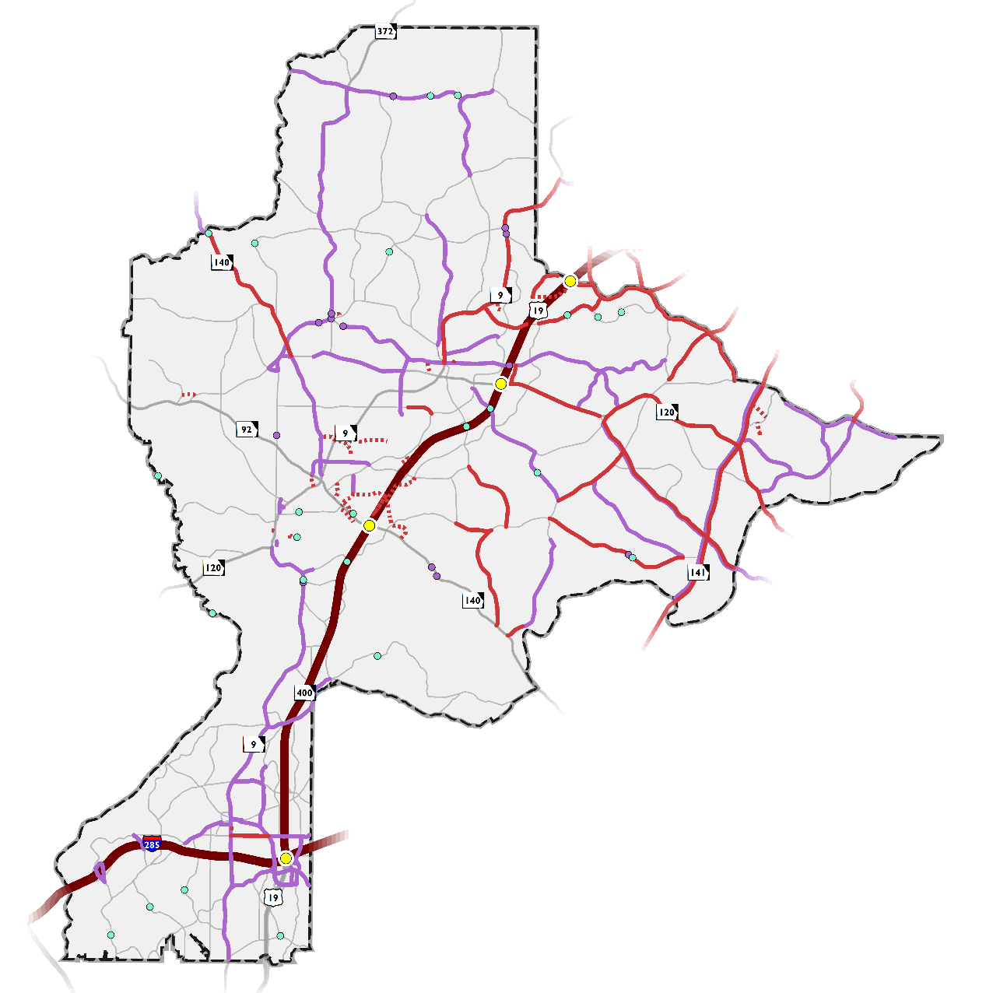
Operational
Purpose: work within existing ROW to optimize performance of roadway
What’s included?
Includes: signal timing, roadway restriping, addition of turn lanes, geometric realignments
Works in tandem with capacity projects

Slide 13
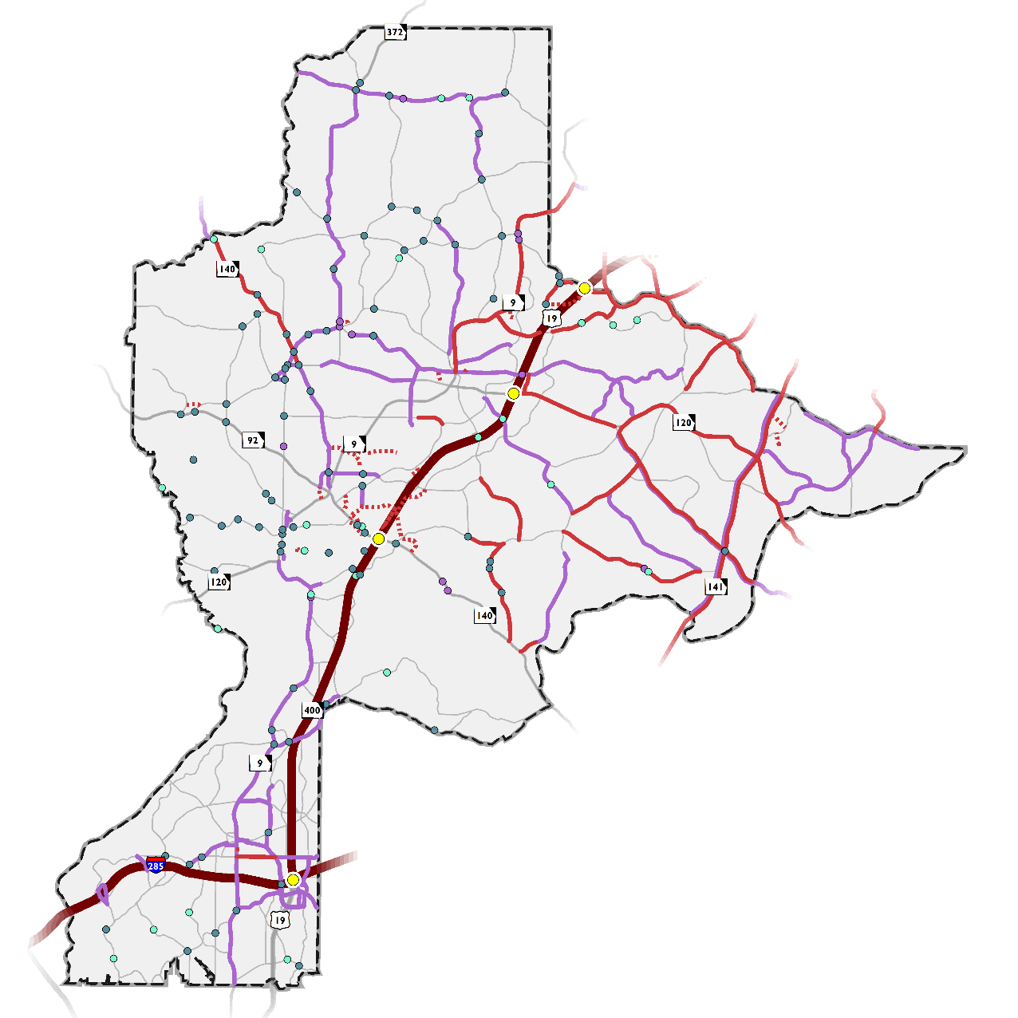
Intersection
Purpose: Increase safety and operational issues of specific locations (not entire roadways)
What’s included?
Improves vehicular, bicycle, and pedestrian access

Slide 14
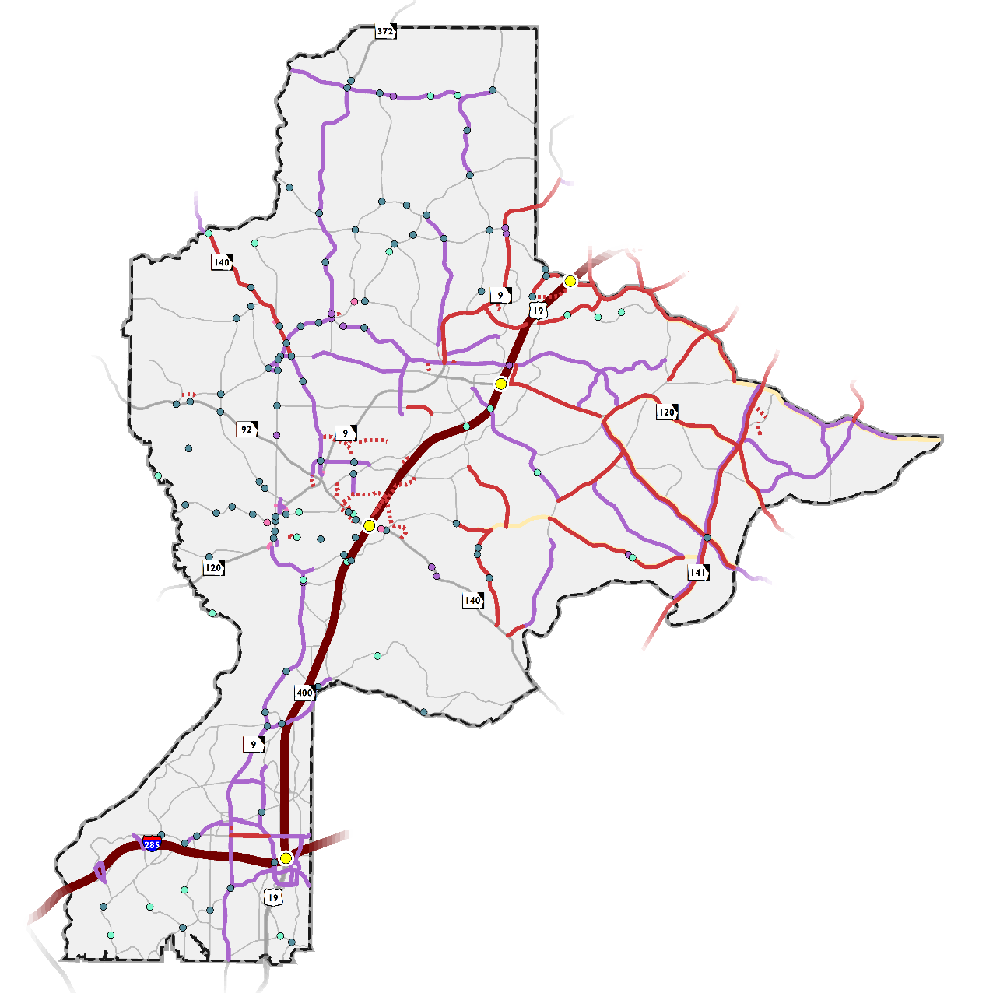
Other Projects
Purpose: placemaking and creating vibrant communities
What’s included?
Includes: beautification and streetscape, roadway realignments

Slide 15
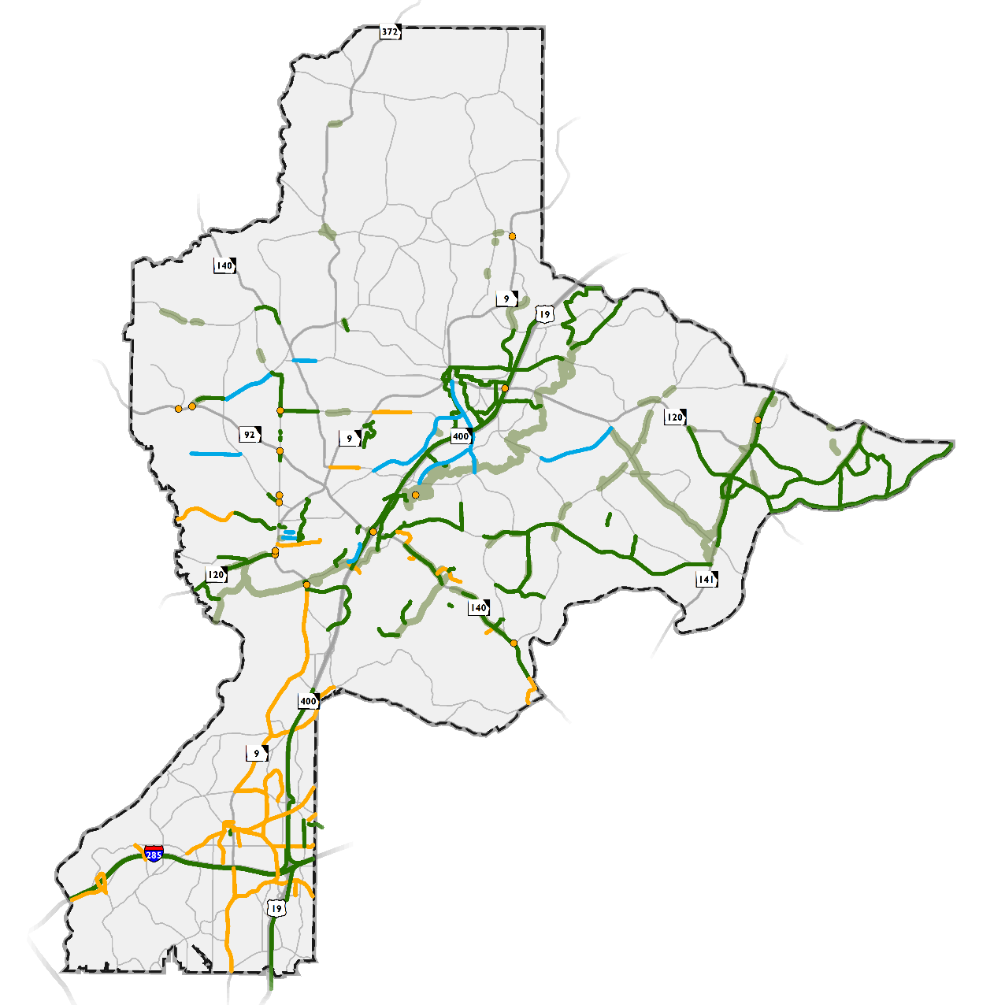
Bicycle, Pedestrian, Trail
Purpose: Enhance pedestrian and bicycle access, connects existing facilities
What’s included?
Includes: bicycle and pedestrian, trail, complete streets

Slide 16
North Fulton – project types by City
*Does not include Major Mobility Investment Program (MMIP) Projects = $16.5 Billion
16

Slide 17
Sandy Springs – Level 1
Projects | City Cost* (in millions)
Capacity | $14.4
New Location | $5.1
Operational | $30.6
Intersection | $15.4
Bicycle and Pedestrian | $38.1
Trail | $11.1
Project Cost Total | $114.7
*Projects that are sponsored by regional and/or statewide agencies are not shown on this map because City is not a direct sponsor.
17

Slide 18
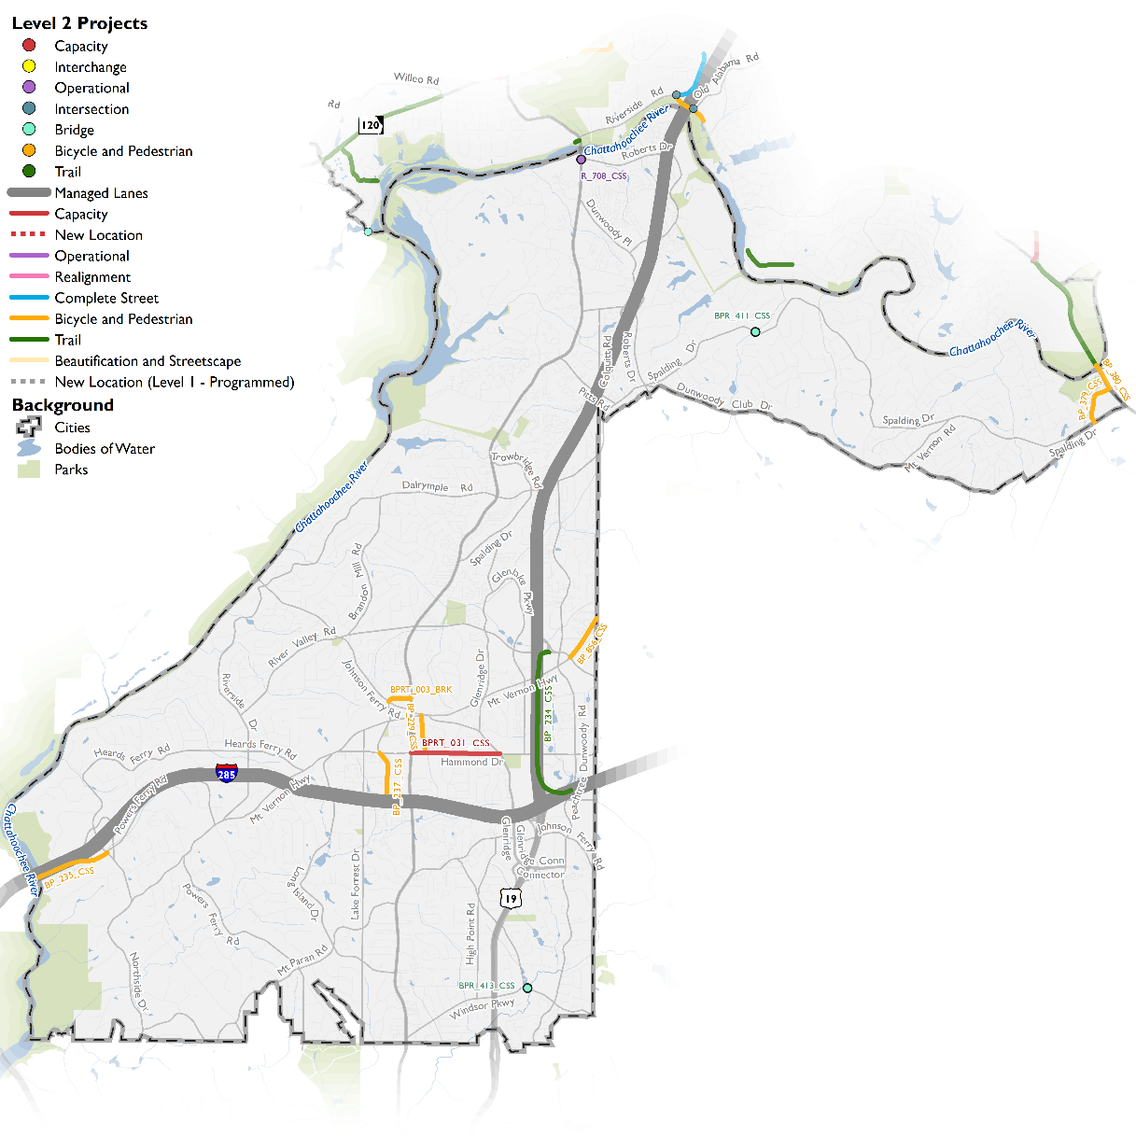
Sandy Springs – Level 2
Projects | City Cost (in millions)
Capacity | $45.6
Operational | $14.5
Bicycle and Pedestrian | $6.7
Trail | $0.8
Project Cost Total | $67.6
Programs | City Cost (in millions)
Sidewalks | $10.0
Storm Water | $5.0
Conceptual Studies | $1.0
Transit | $2.5
Autonomous and Connected Vehicles | $2.5
Programmed Funding Total | $21.0
18

Slide 19
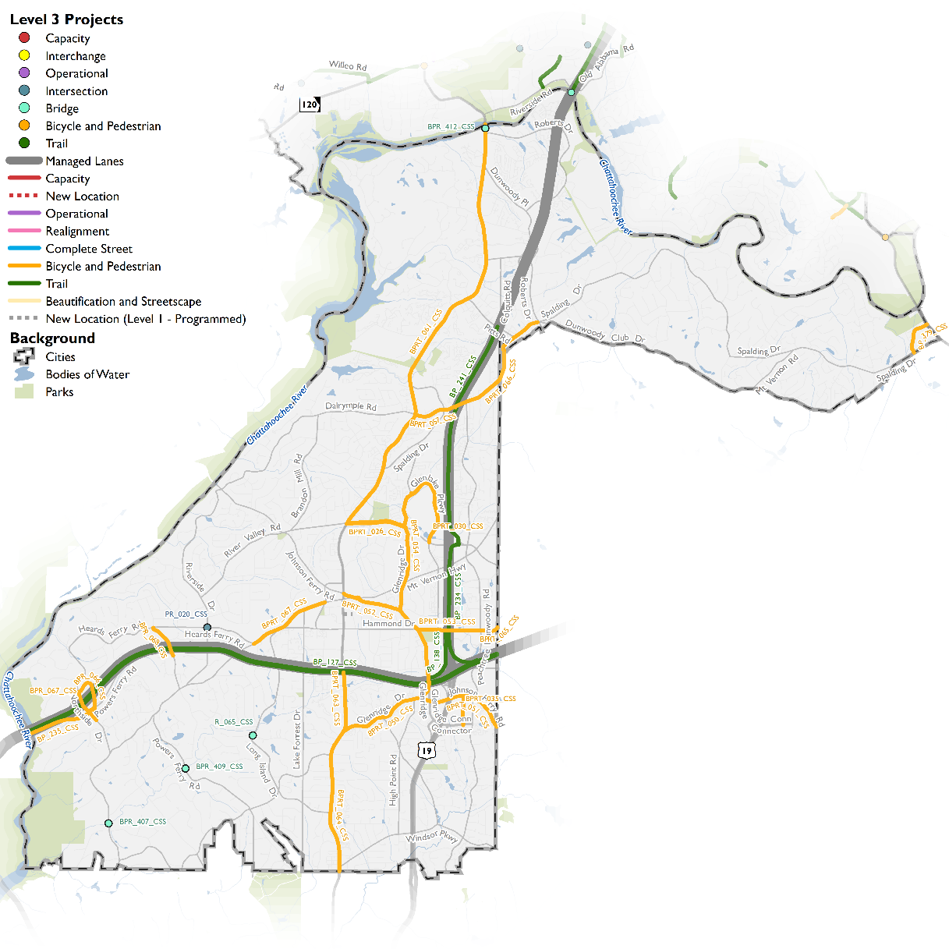
Sandy Springs – Level 3
Projects | City Cost (in millions)
Operational | $7.8
Intersection | $2.4
Bicycle and Pedestrian | $48.2
Trail | $9.3
Project Cost Total | $67.7
Programs | City Cost (in millions)
Sidewalks | $10.0
Storm Water | $5.0
Conceptual Studies | $1.0
Transit | $2.5
Autonomous and Connected Vehicles | $2.5
Programmed Funding Total | $21.0
19

Slide 20
Next Steps
Adoption by North Fulton Cities
Sandy Springs – February 20
Milton – February 21
Mountain Park – February 26
Alpharetta – March 5 (work session), adoption later in March
Johns Creek – March TBD
Roswell – adopted in 2017
20

Slide 21
SANDY SPRINGS CITY COUNCIL MEETING
February 20, 2017

